Slide 1


State abstraction for decision making

Slide 2
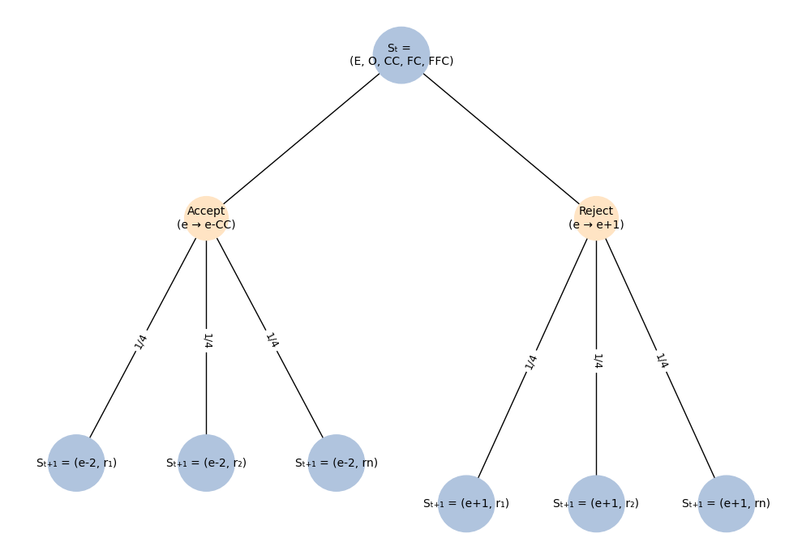
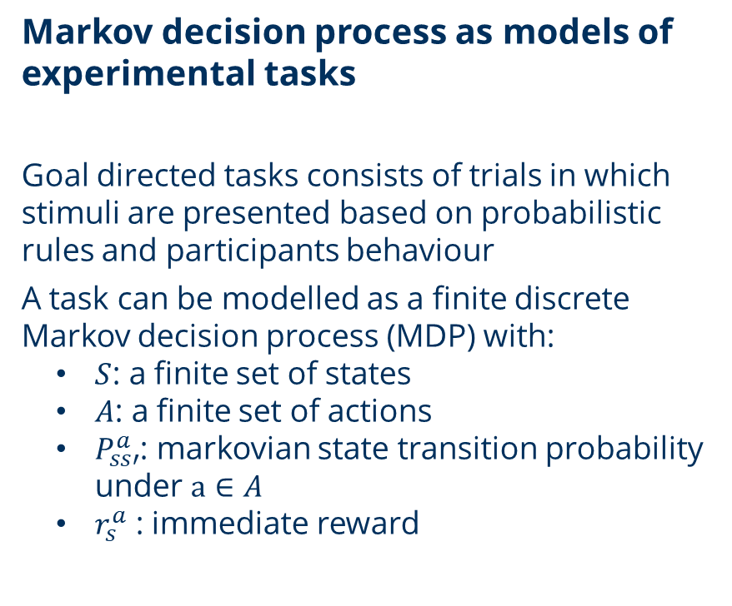
Introduction

Slide 3
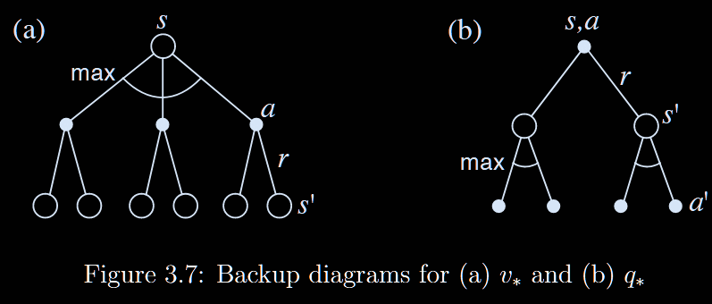
Introduction
Maximizing return requires solving the MDP
  Performing the task well consists of obtaining the highest total reward
  In MDP with fully observable model, there is one solution (i.e. Policy) that yields the best possible return
  The optimal policy can be computed with dynamic programming:
    Starting at terminal state, value is the immediate reward + (discounted) value of the next state

Slide 4
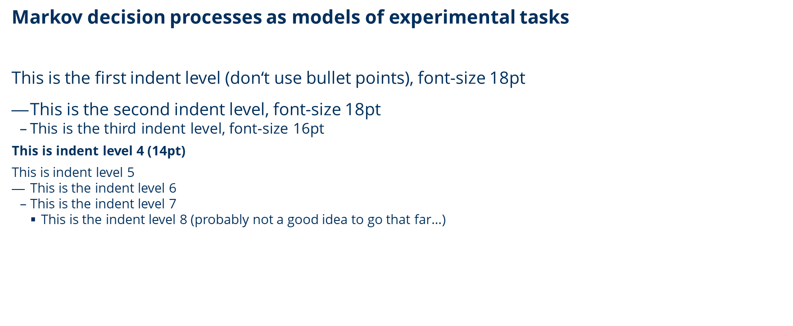
Introduction

Slide 5
chapter or section title
Title in bold letter (standard font if no indent is used), two-column layout
  This is the first indent level (don‘t use bullet points!)
    This is the second indent level
      This is the third indent level
  Here is the second column (indent level 1)
    Indent level 2
      Indent level 3

Slide 6








chapter or section title (image grid)
Use appropriate pictures

Slide 7

chapter or section title (single big image)
Use an appropriate picture

Slide 8
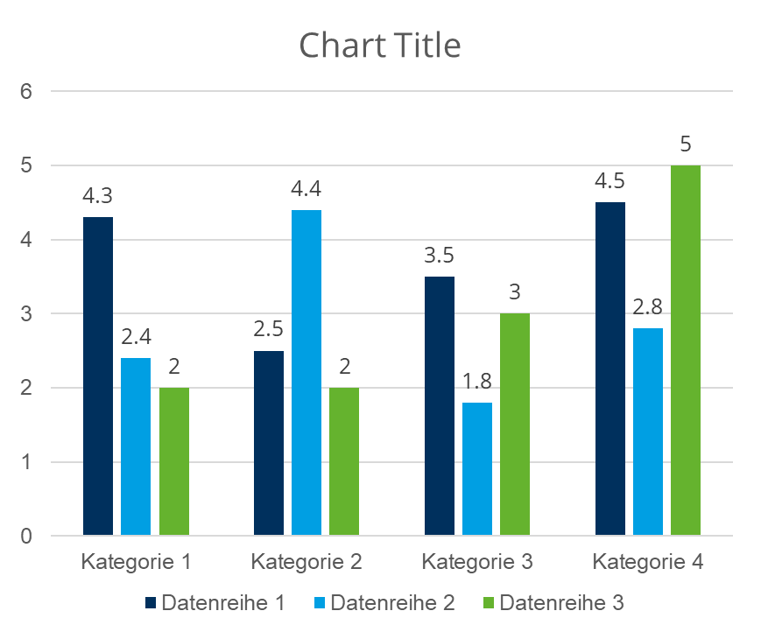
colors
        DRESDEN-concept colors
        Colors of SINS
        (Studieninformationssystem der TUD)

Slide 9




example slide with cooperation partners or funders
Diese Maßnahme wird mitfinanziert durch Steuermittel auf der Grundlage des vom Sächsischen Landtag beschlossenen Haushaltes.

